Slide 1
Cloud Management system
Aya Fouda – Esraa Ismail – Marryam Yahya – Mariam Nabil
Supervised by: Dr. Mohamed Al-Gazzar

Slide 2
Agenda
Introduction
An overview of the whole project and tools used.
Methodology
Functions implementation and connections
Results
Outputs of the functions and effects on the docker
Conclusion and Recommendation
Usage of the management system and future improvements.

Slide 3
Introduction
It will allow users to perform operations on virtual machines and docker based on their inputs
Project aim
Virtual Machine
Docker
GUI
First, the virtual machine is created using QEMU based on user’s specifications.
Next step is to connect to docker to create file, image, and their operations.
Docker and virtual machine, along with user specifications are all connected through GUI functions

Slide 4
Methodology

Slide 5

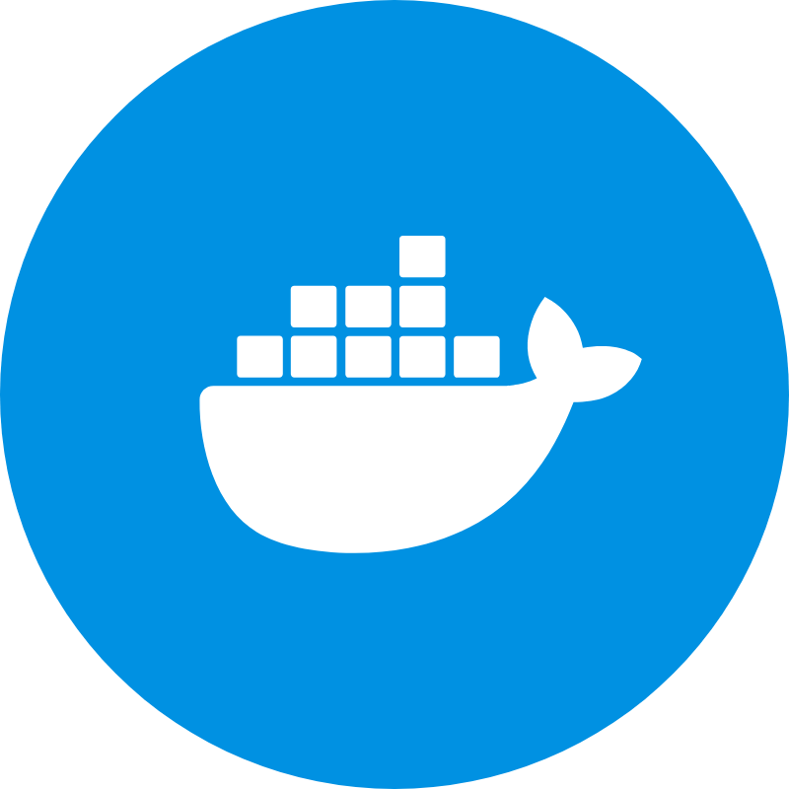
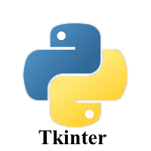
Building the VM
The virtual Machine was created using QEMU. It was built first, VM started with required commands and then operations were ready.
Methods
Docker
Docker files, docker images, list of images and rest of operations were creates as they will be shown later in the implementation functions.
GUI
GUI was not only about the interface, it contained the specified functionalities and connections between all the system features.

Slide 6
Building the VM
The virtual Machine was created using QEMU. It was built first, VM started with required commands and then operations were ready.
Methods
Docker
Docker files, docker images, list of images and rest of operations were creates as they will be shown later in the implementation functions.
GUI
GUI was not only about the interface, it contained the specified functionalities and connections between all the system features.

Slide 7
Code Implementation

Slide 8

Create a Virtual Machine
List all containers
Create Docker file
Stop a container
Build docker image
Search Image
Search Images on Docker Hub
List Docker Images
Download/pull Image

Slide 9
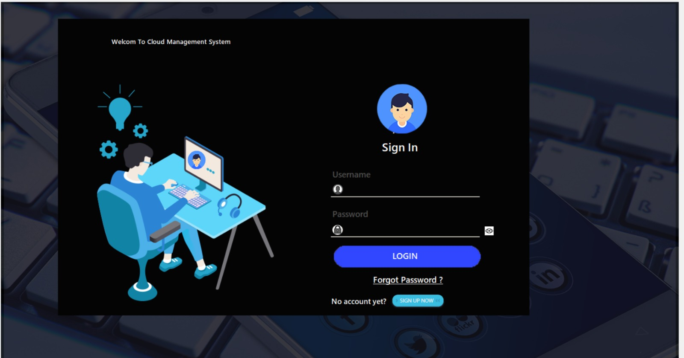

Slide 10
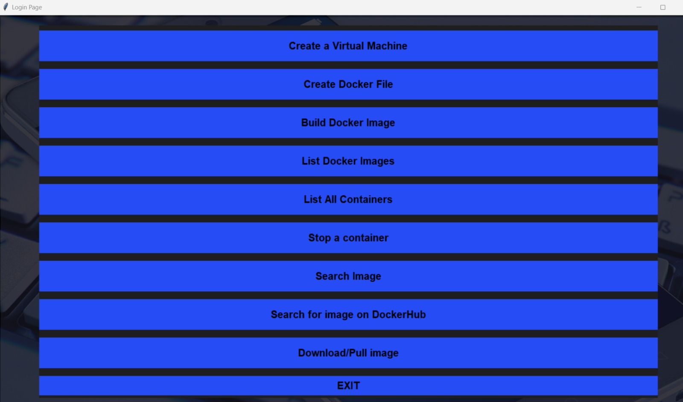

Slide 11
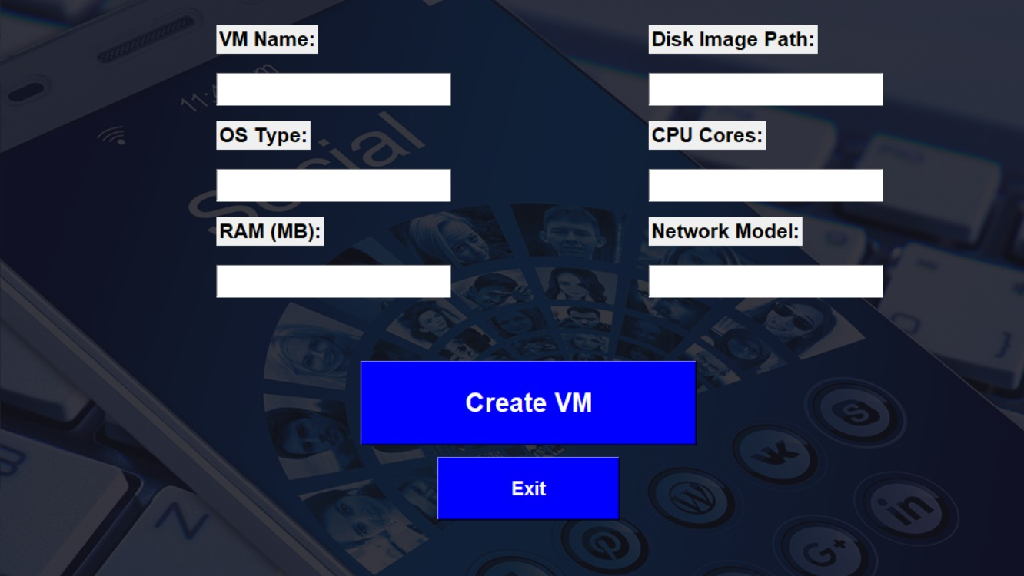

Slide 12
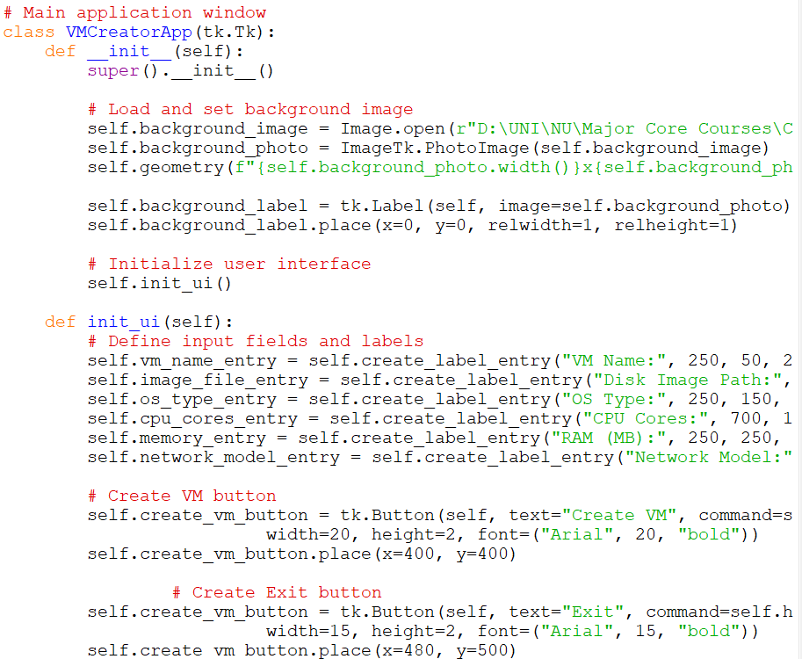
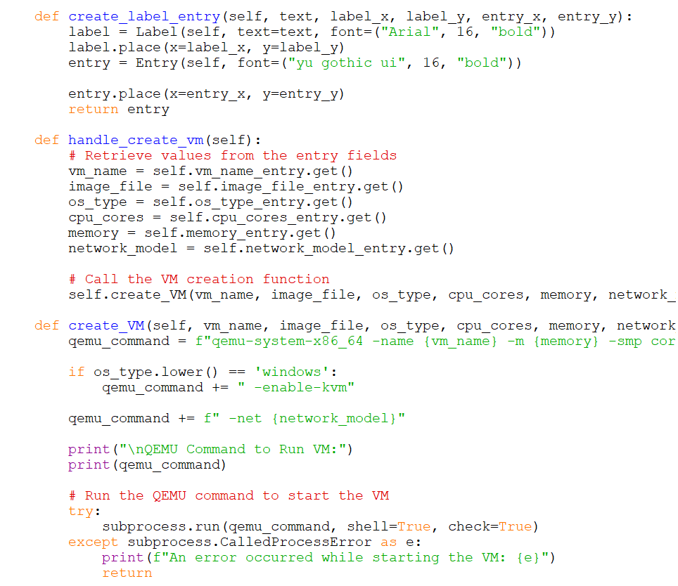

Slide 14
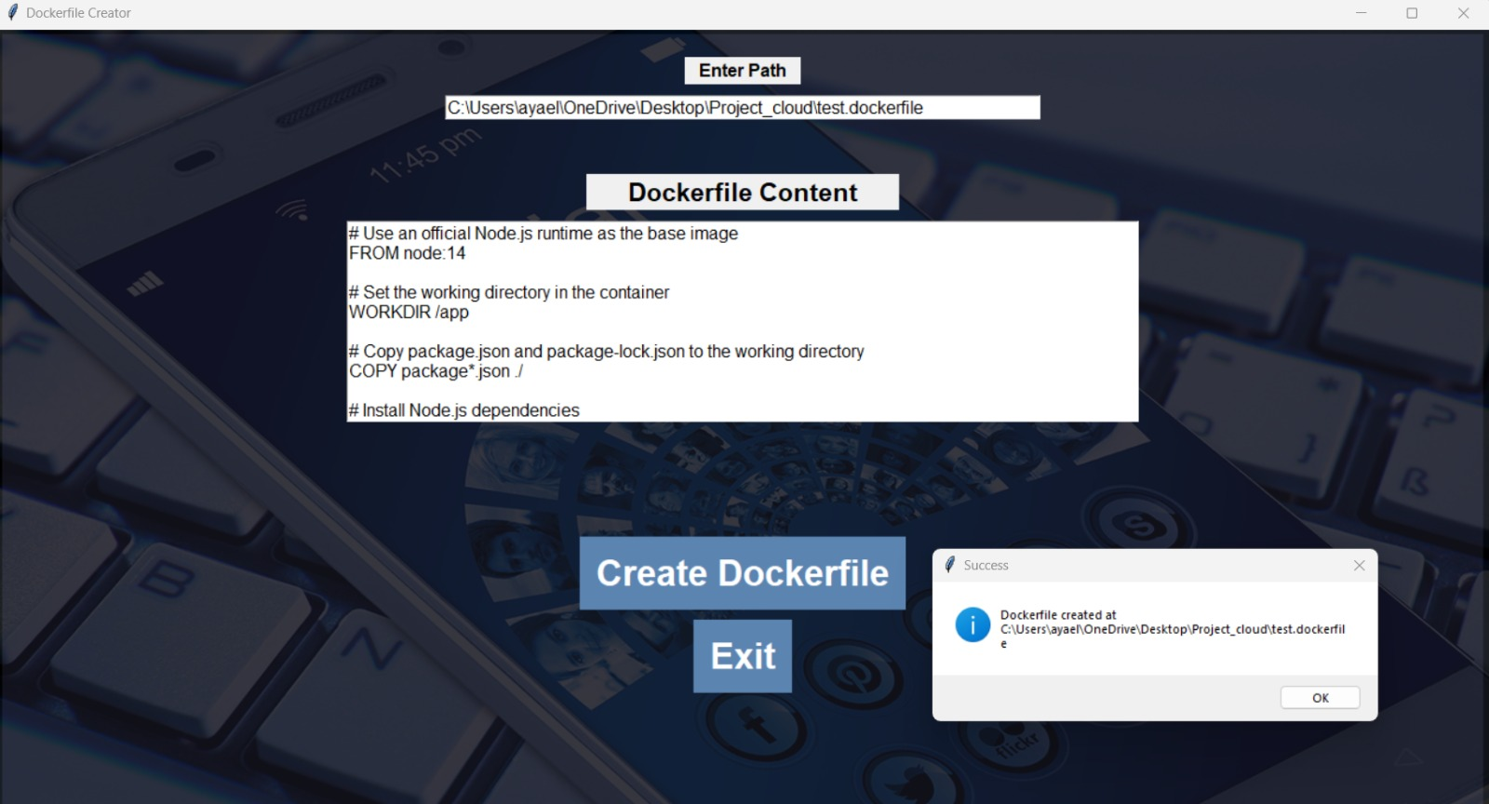

Slide 15
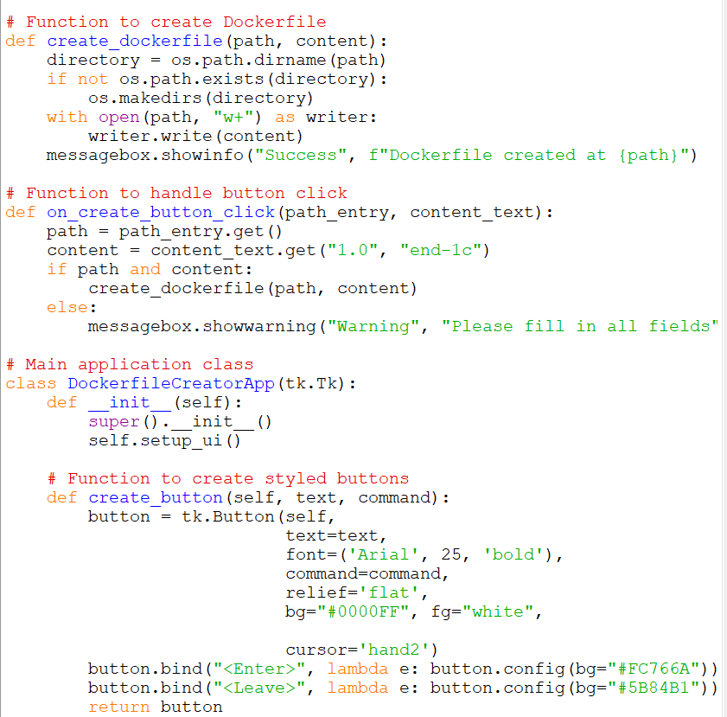
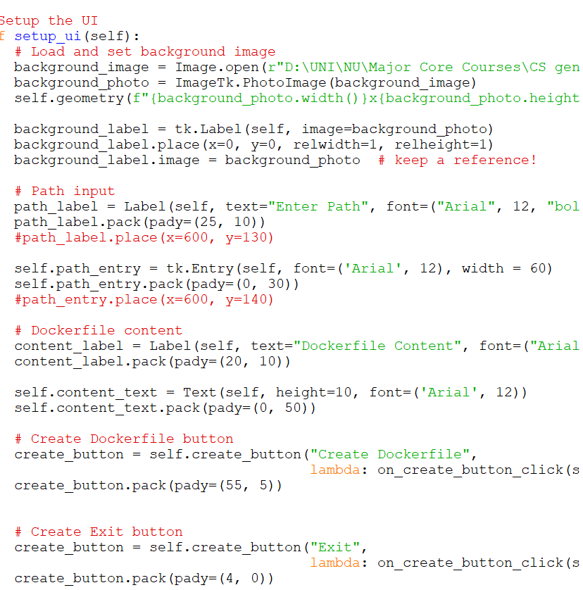

Slide 17
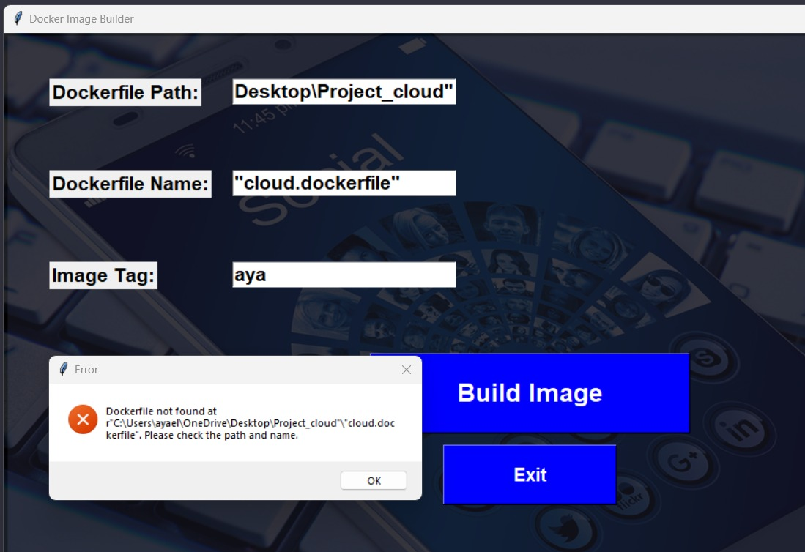

Slide 18
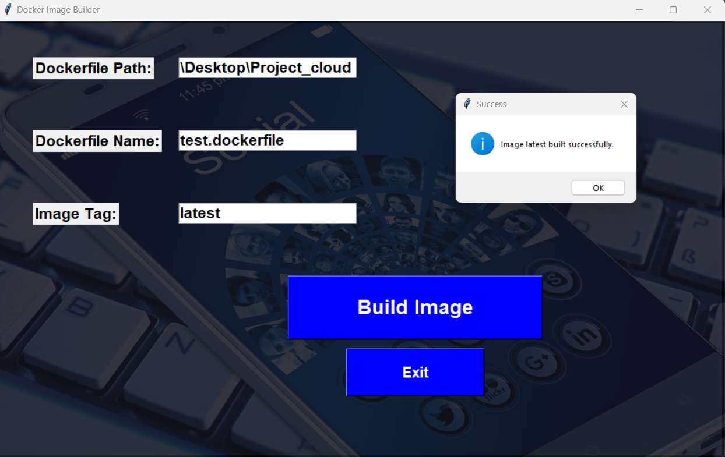

Slide 19
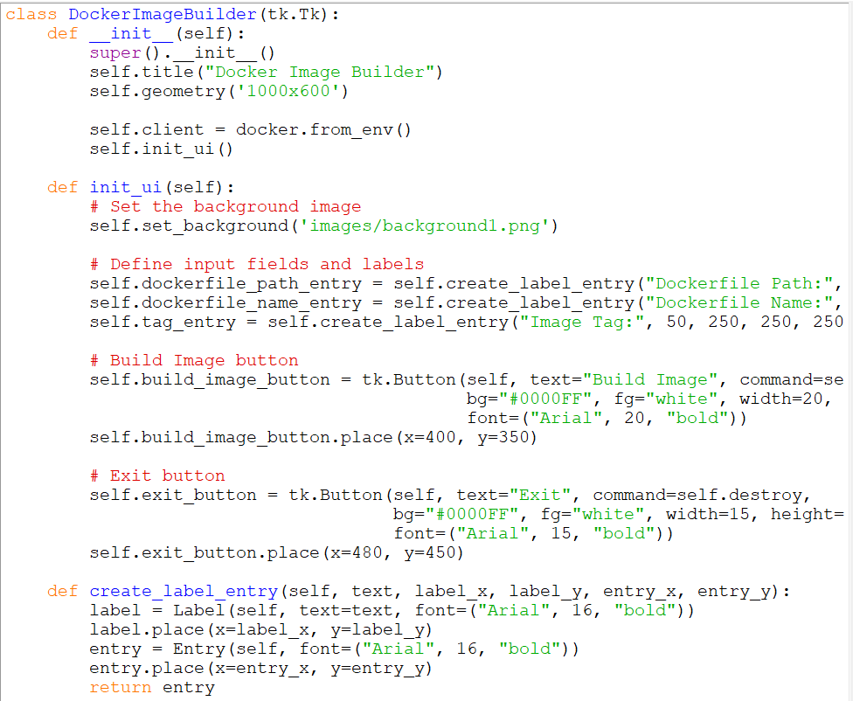
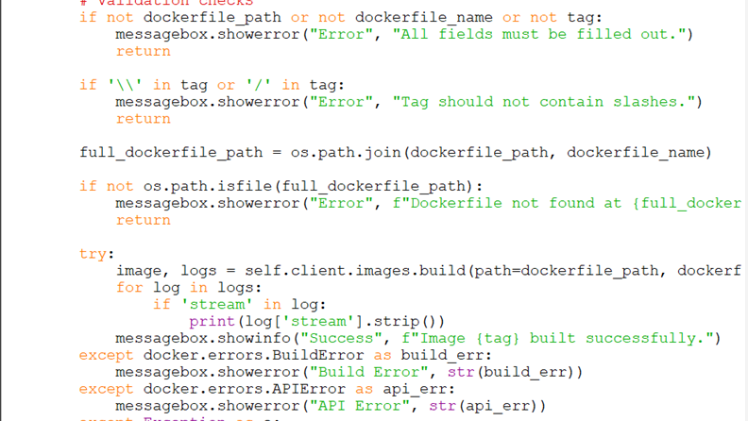

Slide 21
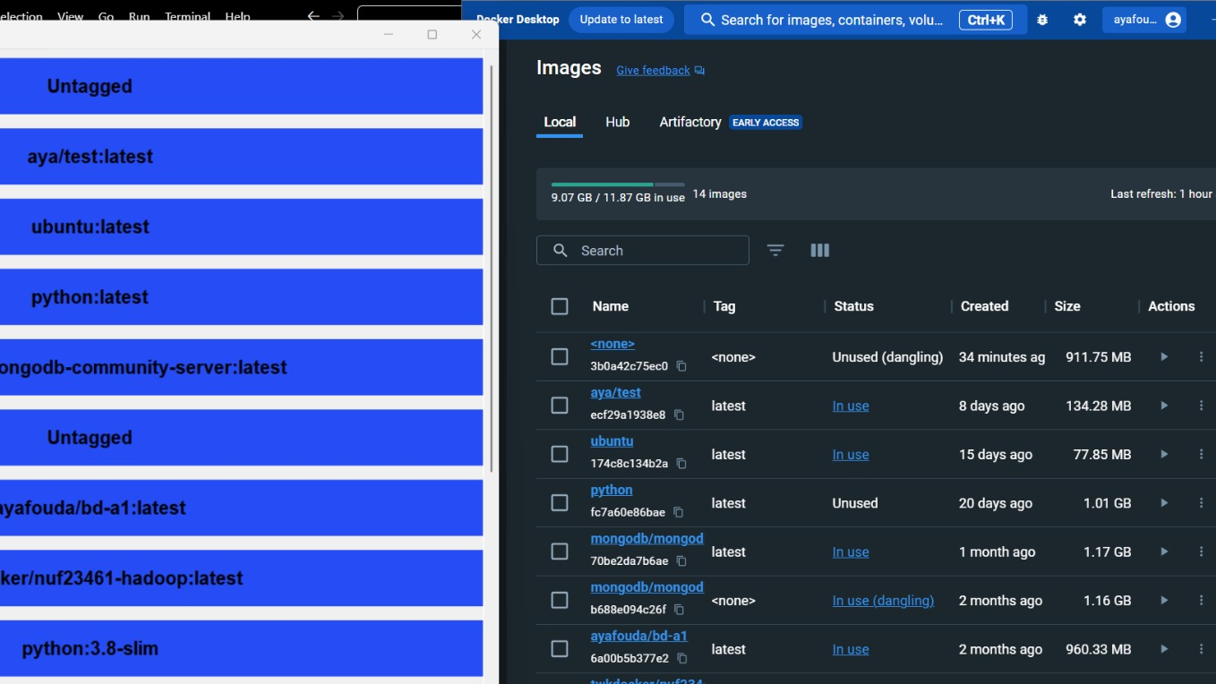

Slide 22
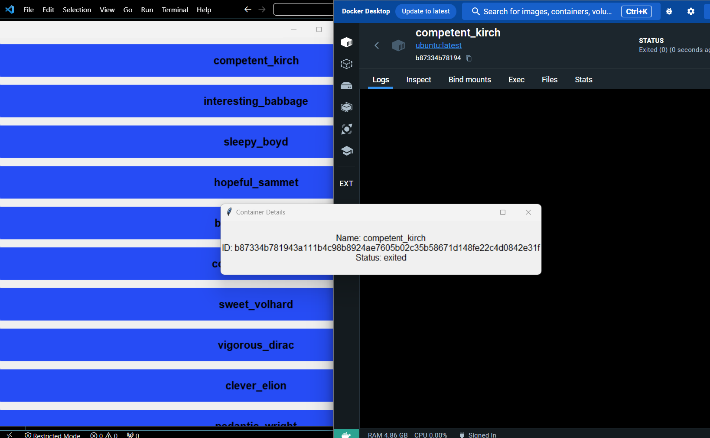

Slide 23
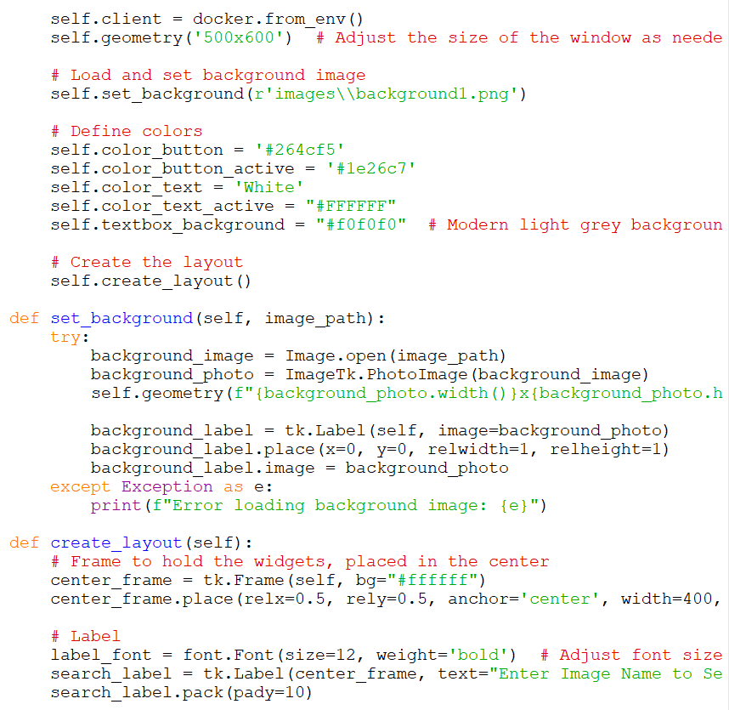
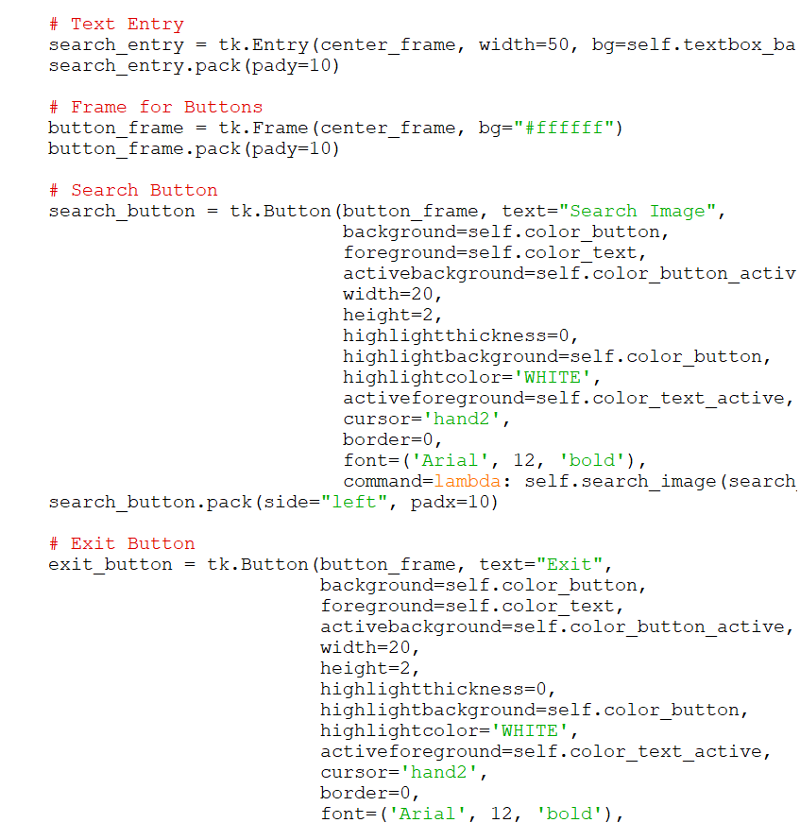

Slide 25
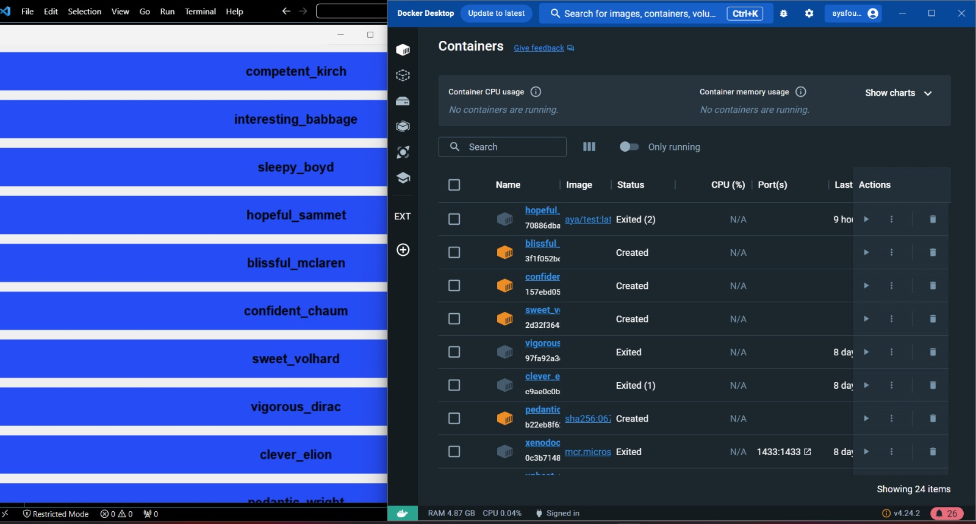

Slide 26


Slide 27
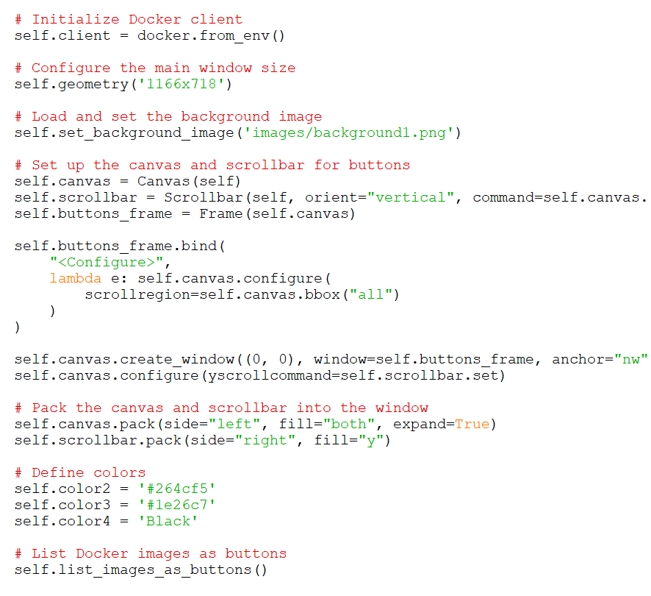
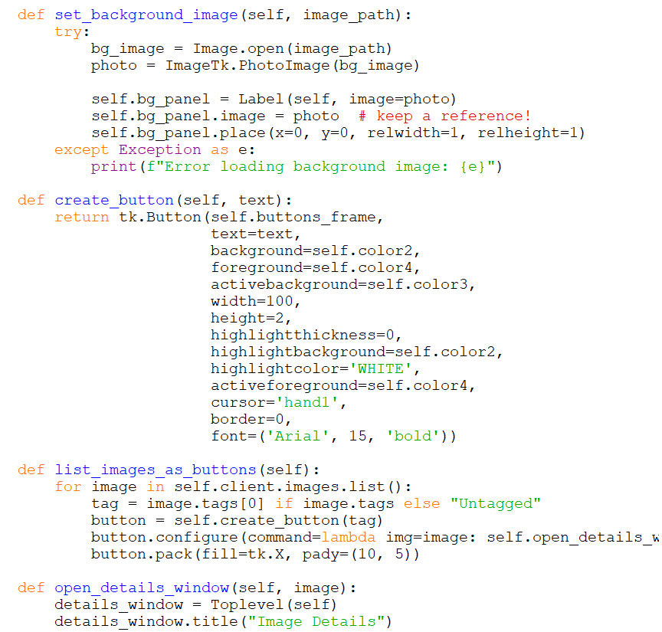

Slide 29
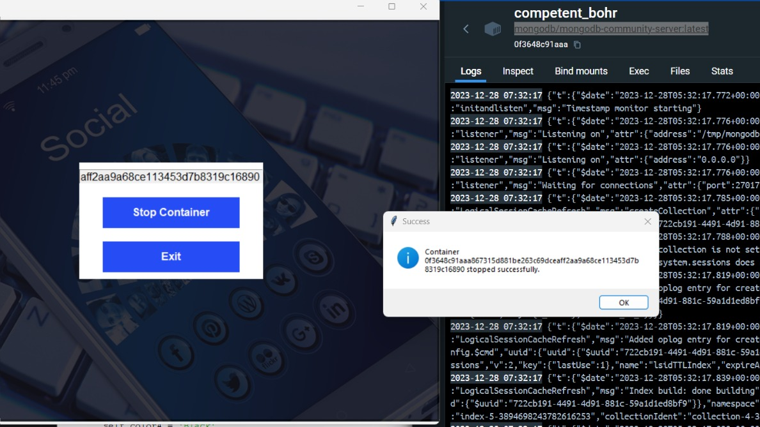

Slide 30
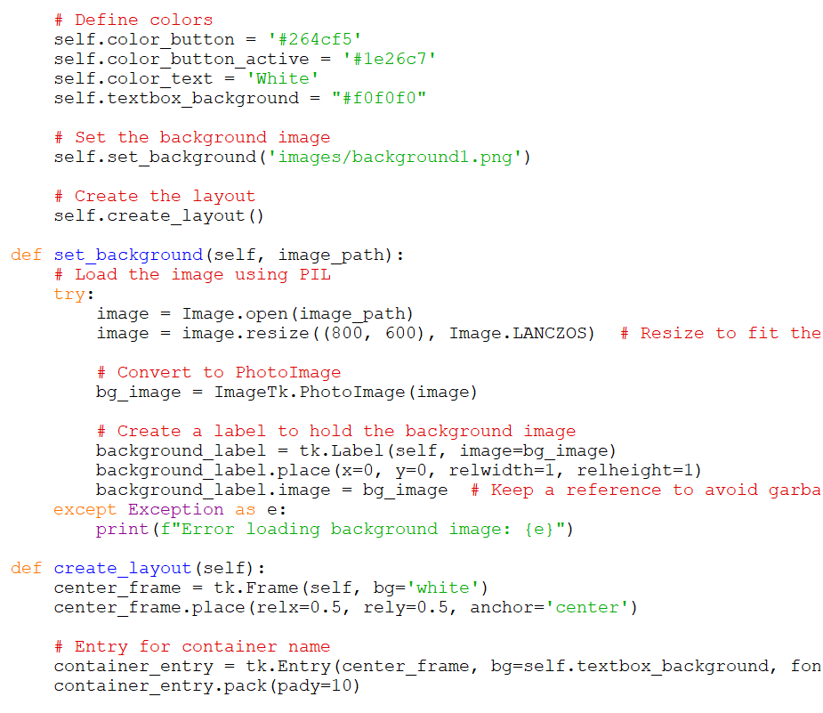
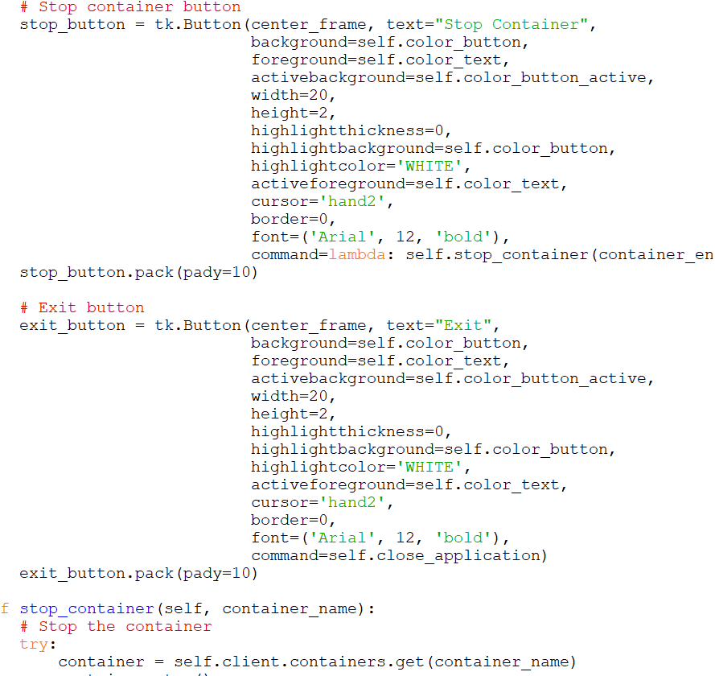

Slide 32
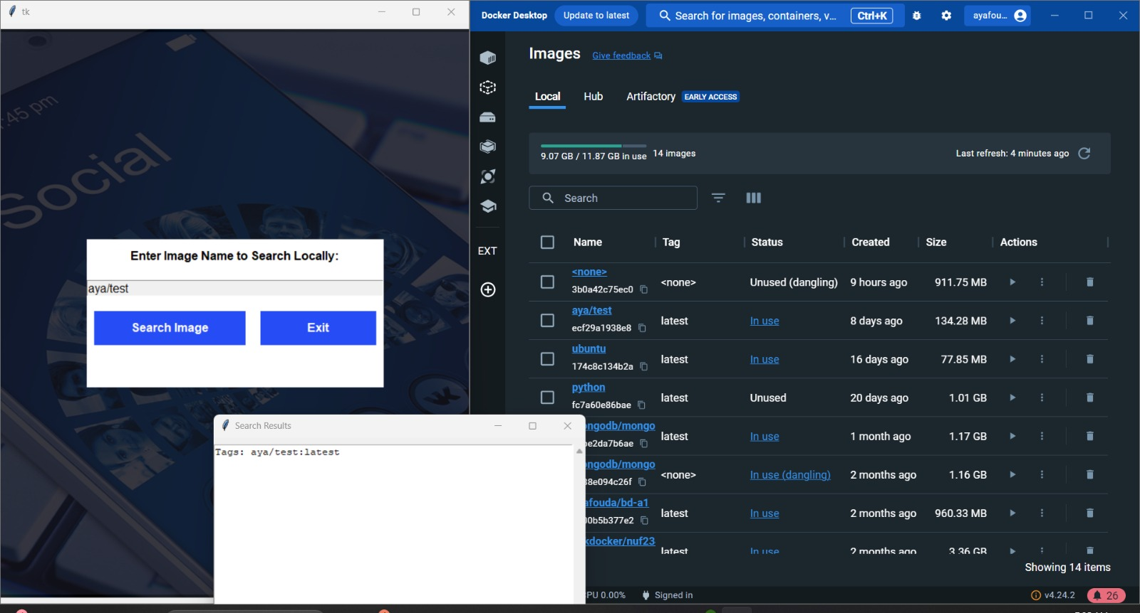

Slide 33
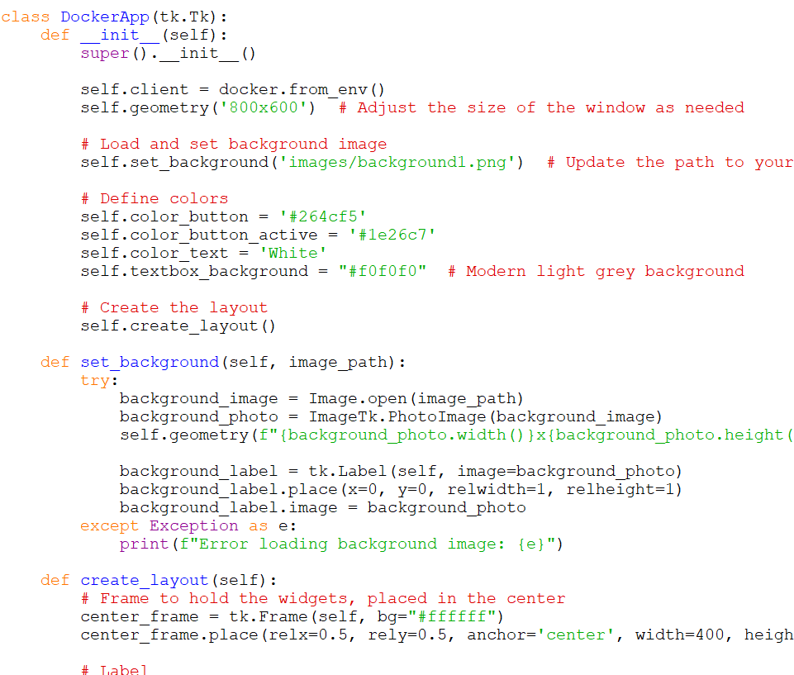
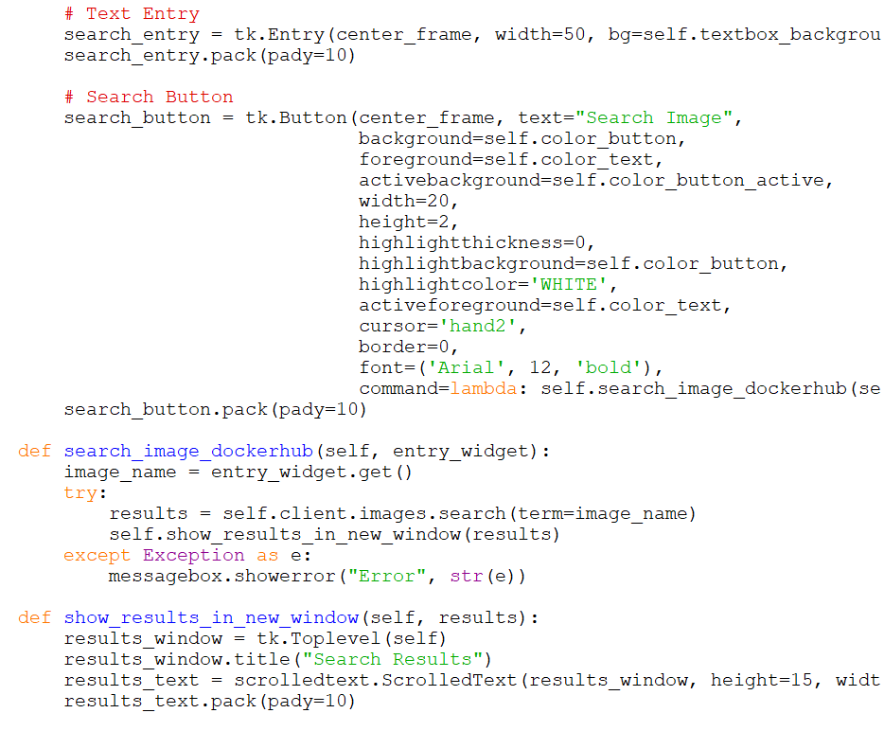

Slide 35
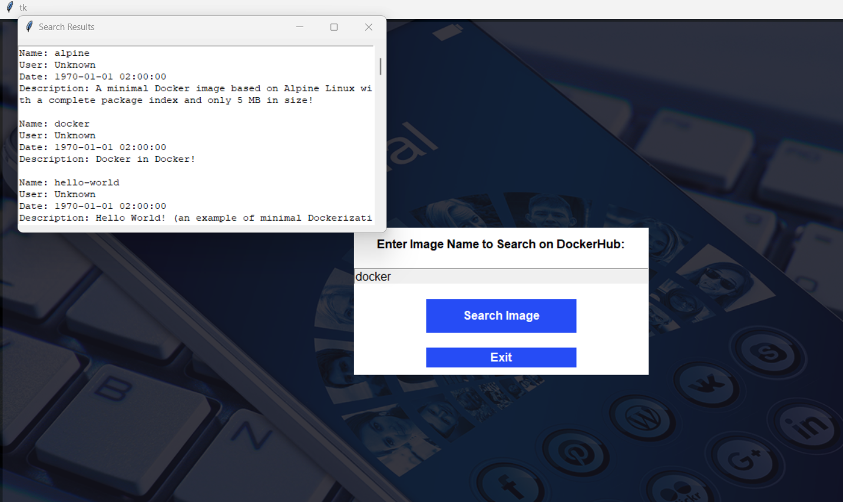

Slide 37
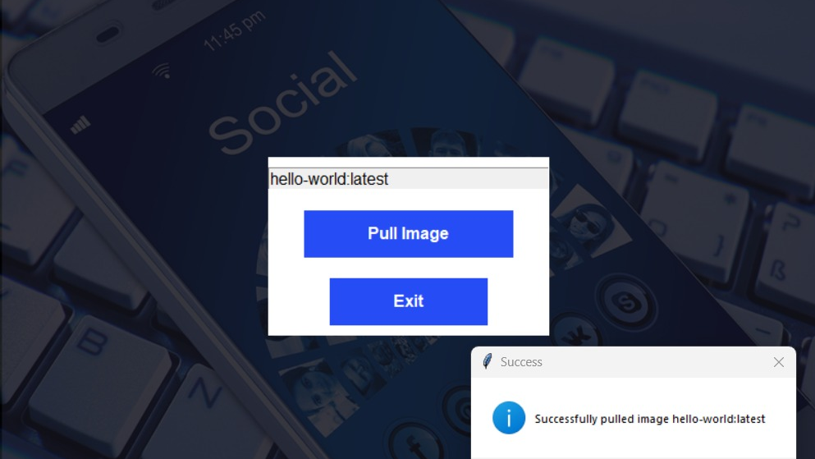

Slide 38
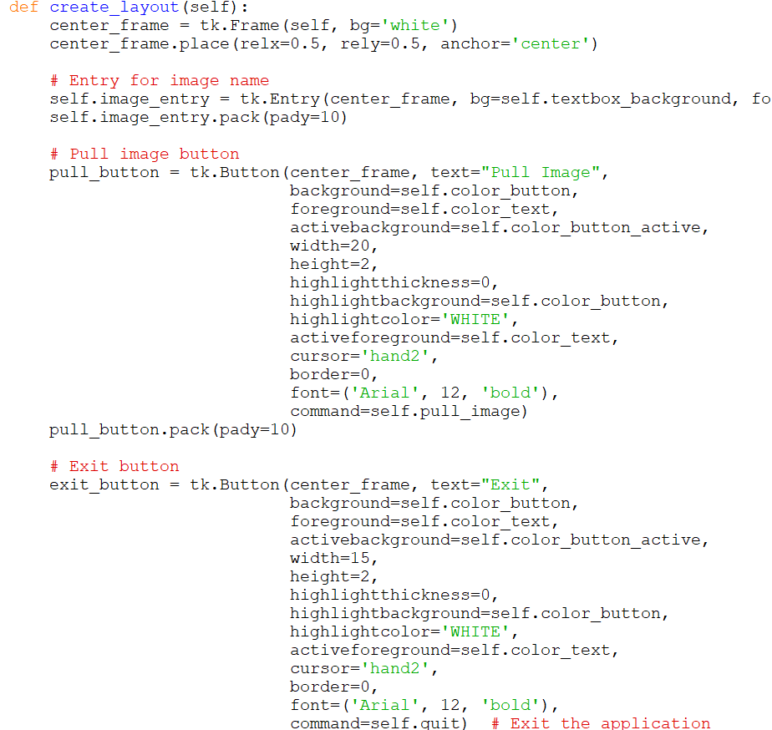
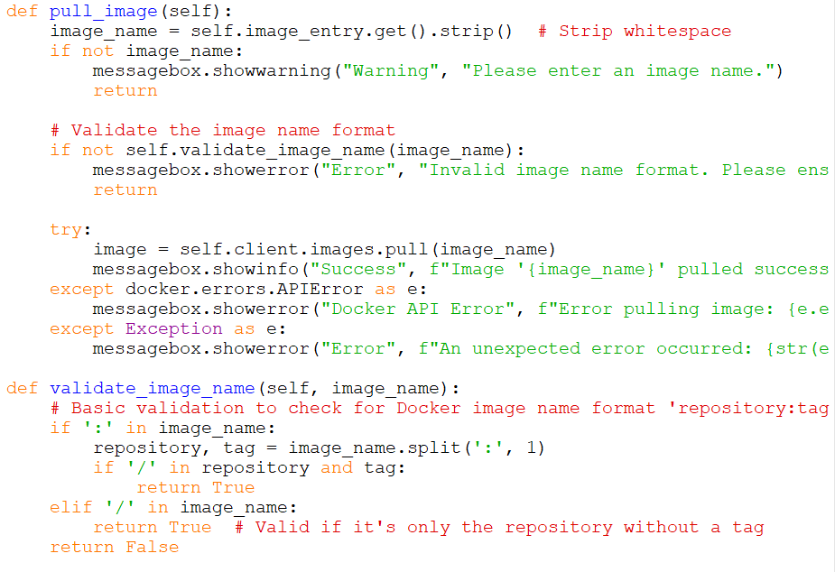

Slide 39
Conclusion
This cloud management system aimed first to create a virtual machine, based on the user specific requirements in RAM, OS type, CPU cores, and paths and then connect it to docker. There is a list of functionalities for each task including build image, list images, list container, search image, pull image, or stop a container. The functions are connected to each other, to transfer the processes, and to the backend basis as VM and Docker. The whole GUI is implemented in python by tkinter library.

Slide 40
Thank you
Insert the title of your subtitle Here

